Slide 1

MOVIE & EVENT BOOKING APPLICATION

Slide 2

CONTENT
01
ABSTRACT
02
INTRODUCTION
03
TECHNOLOGIES
04
FEATURE
05
DATABASE SCHEMA
06
SCREENSHOT’S
07
CONCLUSION

Slide 3


ABSTRACT
The Multi-User Movie and Event Ticket Booking Application is a sophisticated platform that streamlines the process of booking movie tickets across theaters. It caters to both regular users and administrators, featuring a comprehensive database schema for secure authentication and efficient management. The Flask API, with endpoints for authentication, theater management, and more, serves as the backbone. Role-based access control ensures security, and the interface is designed for clarity. The technology stack includes Vue.js, Flask, HTML, CSS, Bootstrap, Redis, Celery, Chart.js, JWT, and SQLite. Admins can manage theaters and movies with multilingual support, and users can easily reserve multiple tickets. The system supports CSV exports of theater details, and overall, it provides a modular, user-friendly platform with secure interactions, efficient management, and customization options.

Slide 4
INTRODUCTION
The Multi-User Event and Movie Booking Application is a comprehensive platform that seamlessly integrates the booking process for both movies and various events across different venues. This user-friendly application is designed to cater to the needs of both regular users and administrators, providing efficient management of movie bookings, event reservations, venue details, and show schedules. With its intuitive interface and robust features, this app aims to enhance the overall experience of users, offering a one-stop solution for booking tickets to movies and diverse events. Whether it's a blockbuster film or a live concert, users can easily navigate through the app to secure their bookings and enjoy a seamless entertainment experience.
Drew Holloway
Remy Marsh
Ceo Of Ingoude Company

Slide 5


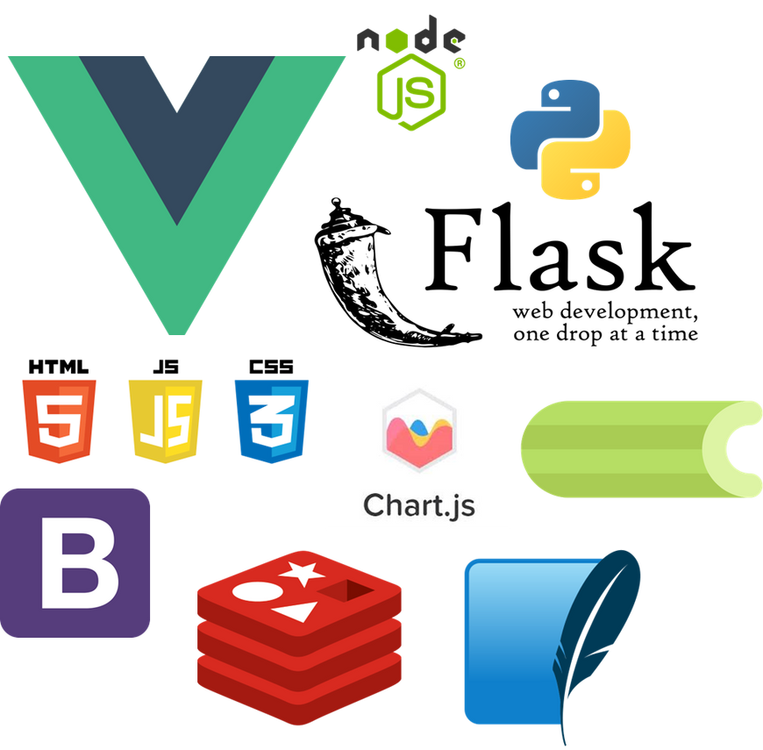
TECHNOLOGIES
·Vue.js
·Flask
·HTML
·CSS
·JavaScript
·Bootstrap
·Redis
·Celery
·Chart.js
·JWT
·RESTApi
·Node.js
·SQLite

Slide 6
FEATURE
Single Page Applications
Progressive Web Apps
Server Side Caching
Job Scheduling
Responsive Web Design
Dynamic Form

Slide 7
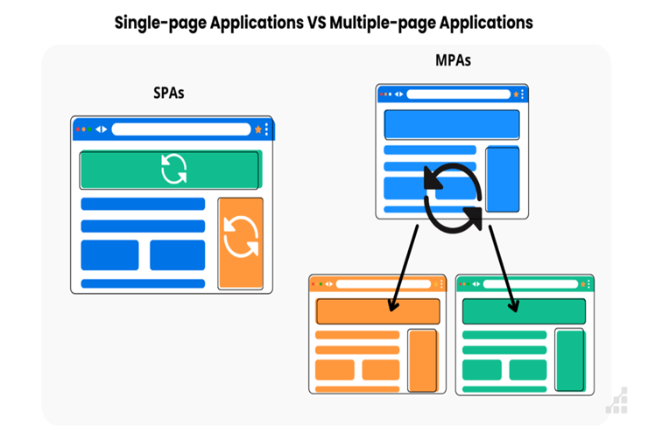
SINGLE PAGE APPLICATIONS(SPA)
A single-page application (SPA) is a web application or website that interacts with the user by dynamically rewriting the current web page with new data from the web server, instead of the default method of a web browser loading entire new pages.

Slide 8
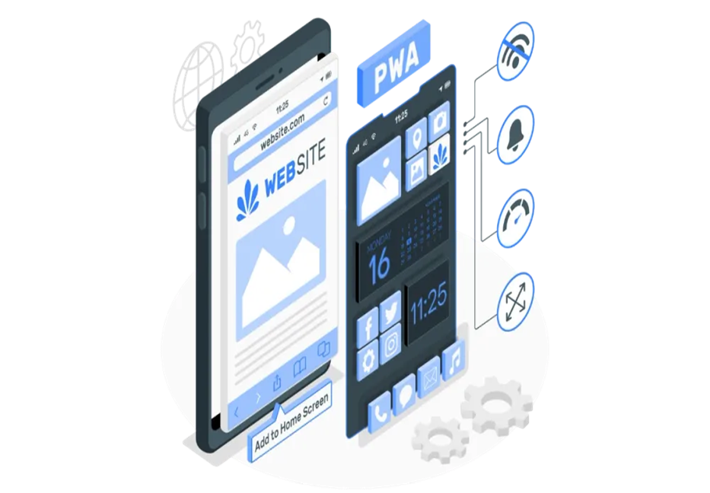
PROGRESSIVE WEB APP(PWA)
A progressive web application, or progressive web app, is a type of application software delivered through the web, built using common web technologies including HTML, CSS, JavaScript, and Web Assembly. It is intended to work on any platform with a standards-compliant browser, including desktop and mobile devices.

Slide 9
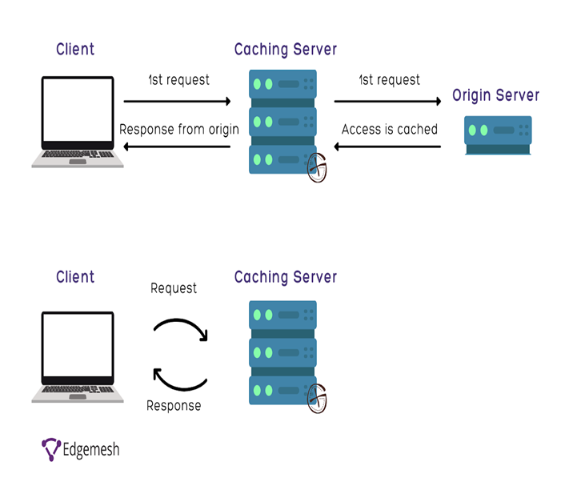
SERVER SIDE CACHING
Server-side caching refers to storing data or responses on the web server or an intermediate proxy server, such as a reverse proxy or a content delivery network (CDN). This reduces the load on the web server and the network bandwidth, as well as the latency for the clients.

Slide 10
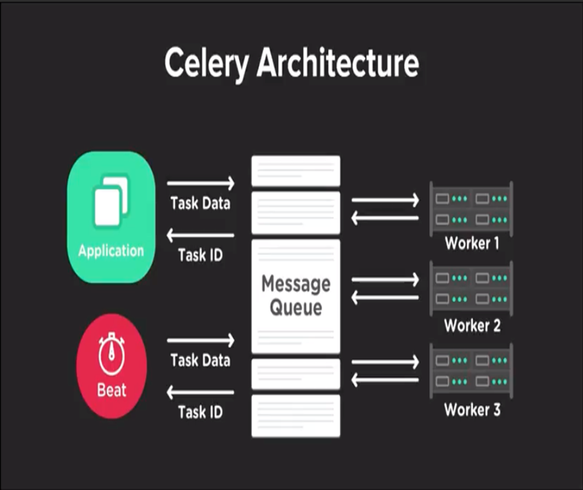
JOB SCHEDULING
Using Celery
Celery is an open-source distributed task queue system that is often used to handle asynchronous tasks in web applications. While it's commonly associated with job scheduling, it's important to clarify that Celery itself isn't a full-fledged job scheduler in the traditional sense. Instead, it's a tool for managing and distributing tasks across a distributed infrastructure.

Slide 11

RESPONSIVE WEB DESIGN
Responsive Web Design is about using HTML and CSS to automatically resize, hide, shrink, or enlarge, a website, to make it look good on all devices (desktops, tablets, and phones):

Slide 12
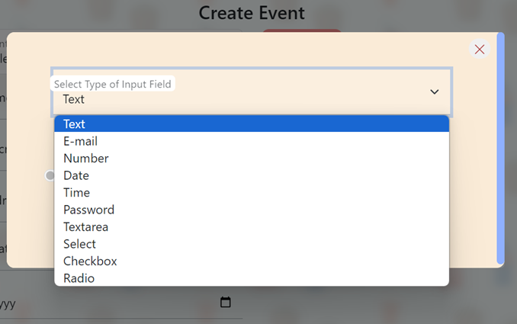
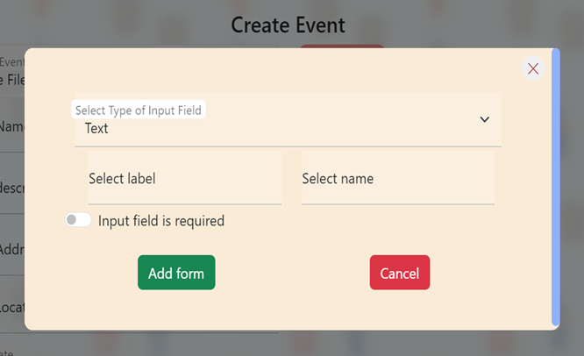
DYNAMIC FORM
A dynamic form feature on your web page, reminiscent of the versatility found in Google Forms. Your innovative approach allows users to interact with an array of input fields, tailoring their experience to meet diverse data collection needs. This dynamic form functionality not only enhances user engagement but also showcases your commitment to providing a user-friendly and customizable interface.

Slide 13
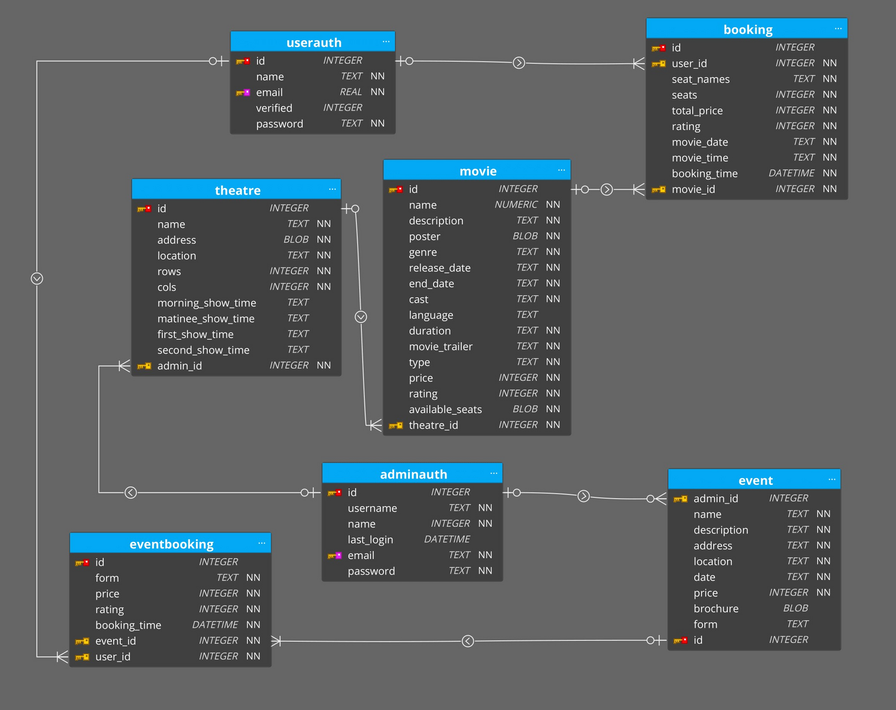
DATABASE SCHEMA

Slide 14
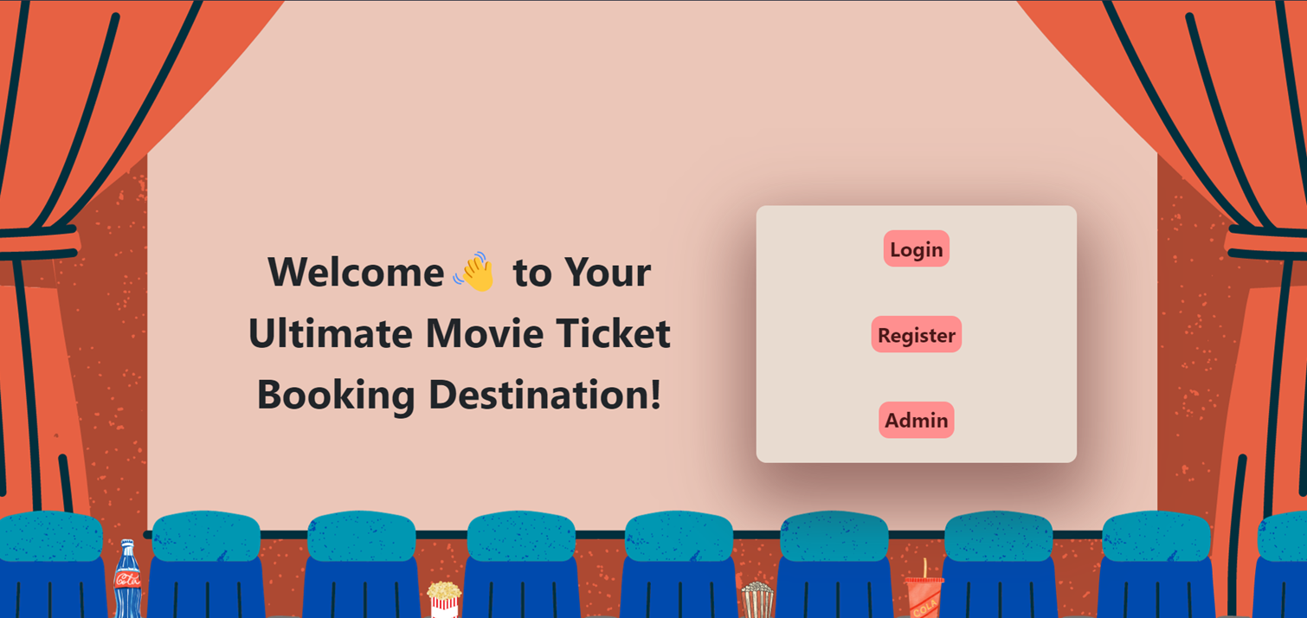
Landing Page

Slide 15
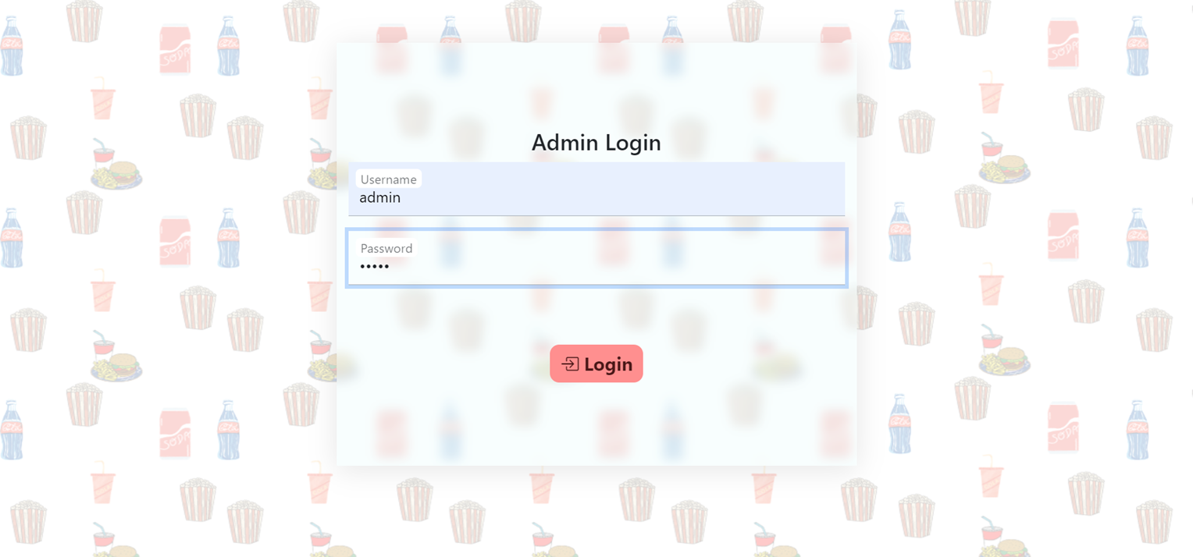
Admin Login Page

Slide 16
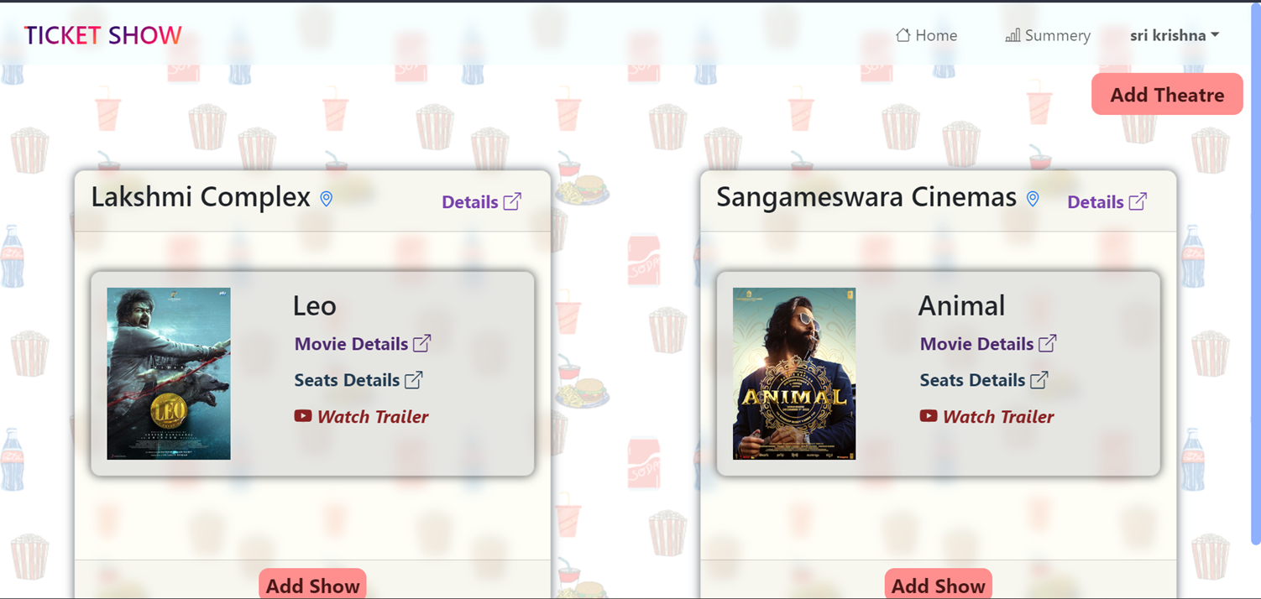
Admin Home Page

Slide 17
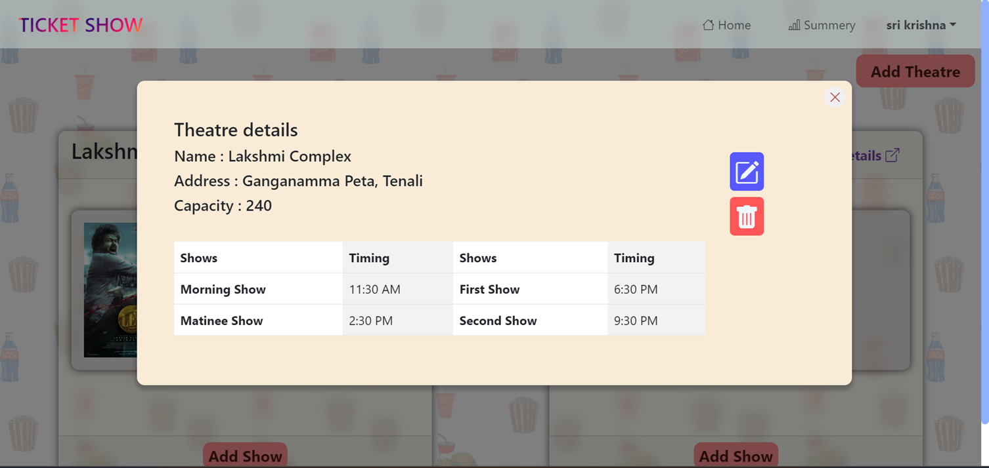
Theater details

Slide 18
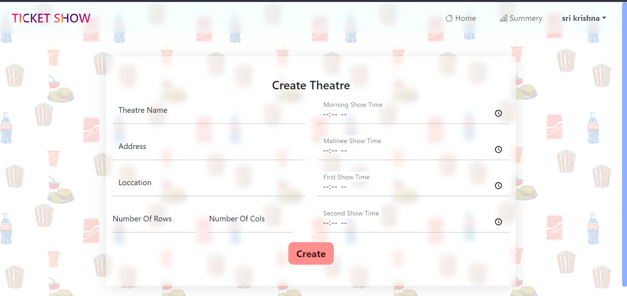
Create theatre Page

Slide 19
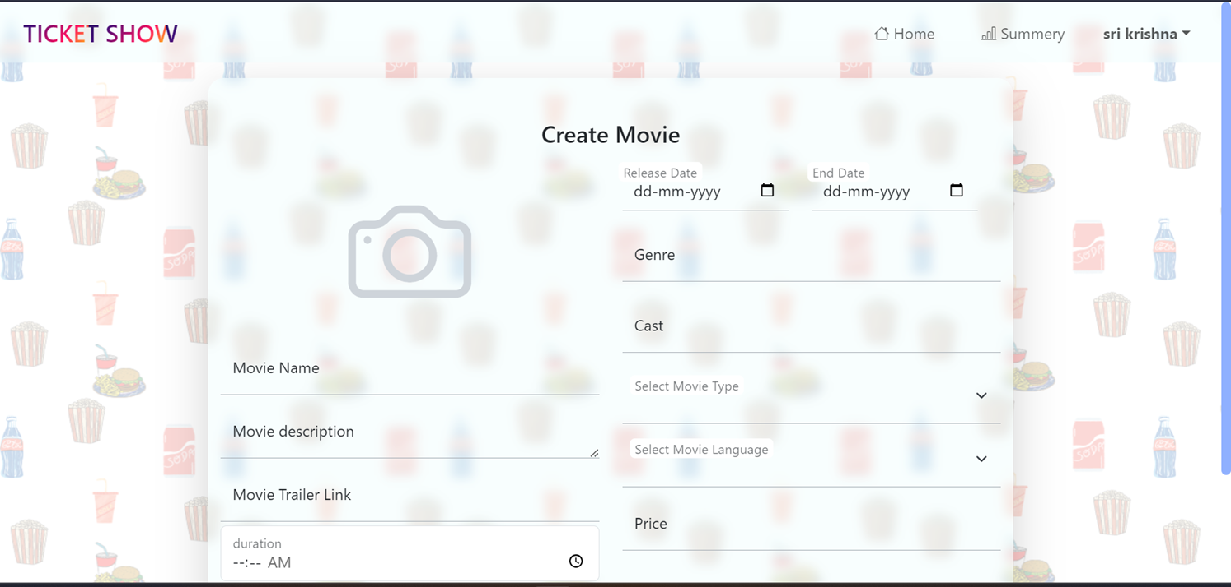
Create movie Page

Slide 20
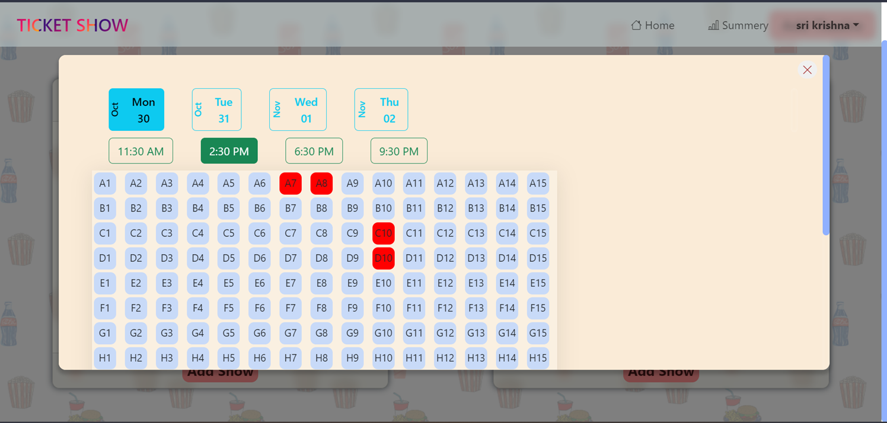
User reserved seats view

Slide 21
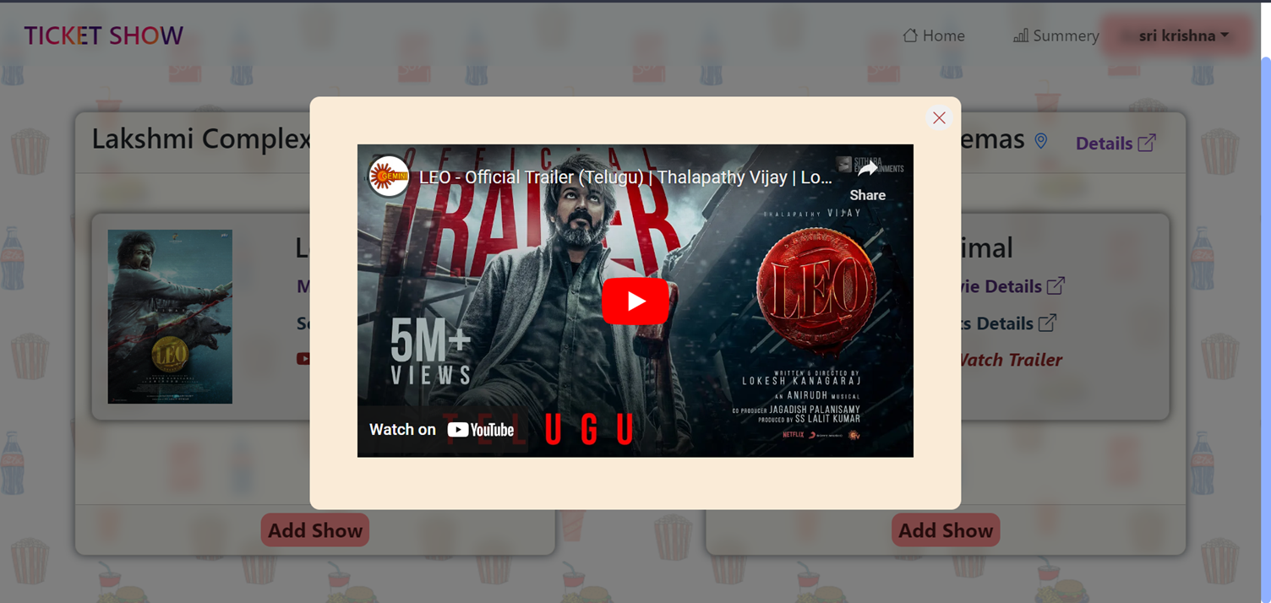
Movie trailer view

Slide 22
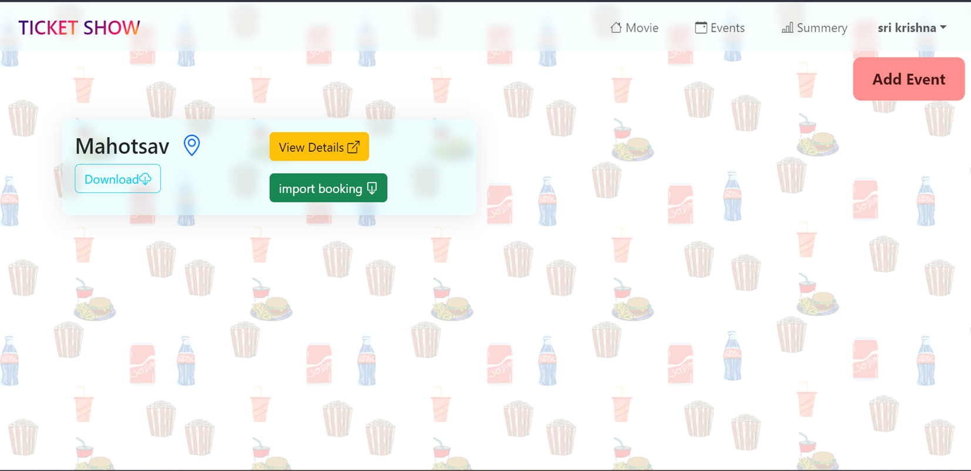
Admin Events home page

Slide 23
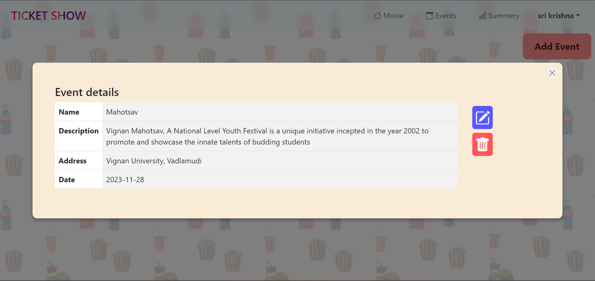
Event details

Slide 24
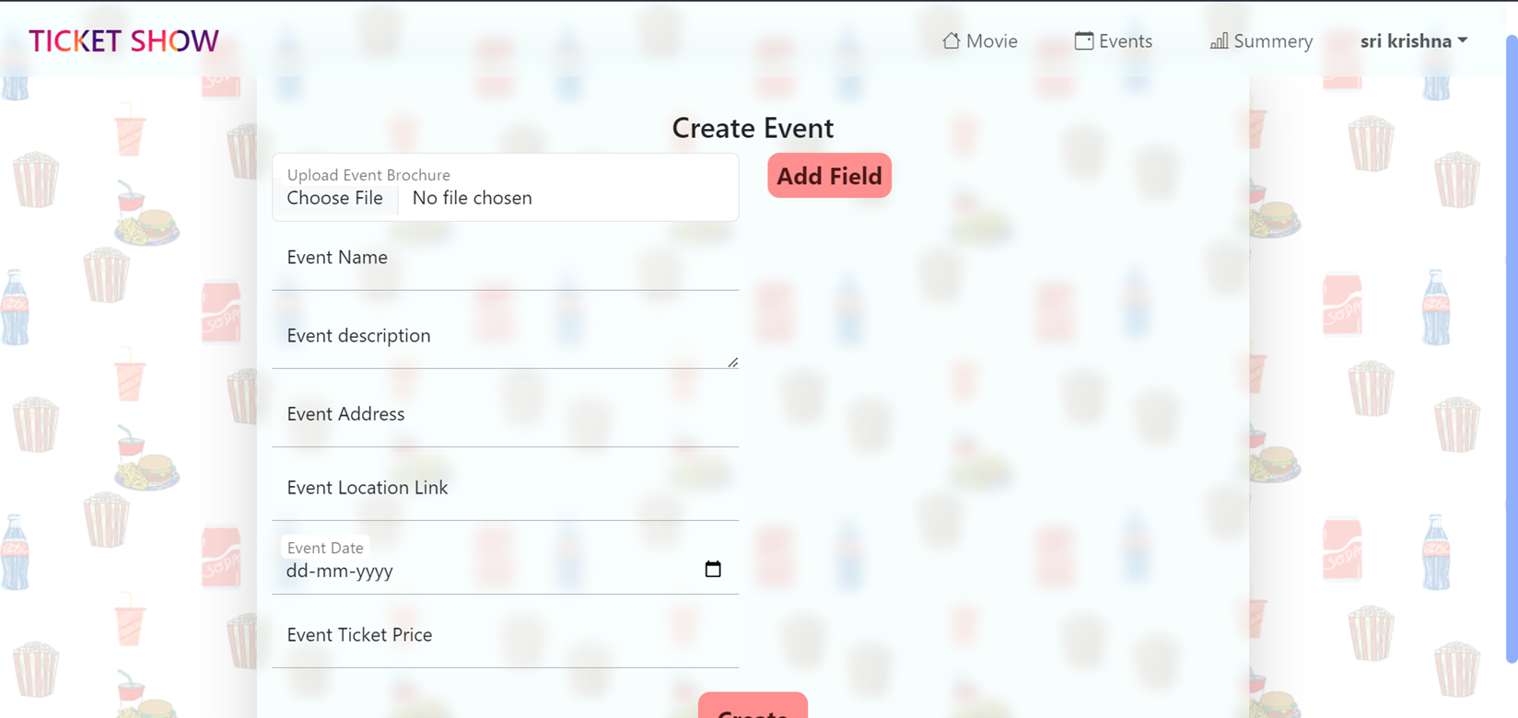
Create event Page

Slide 25
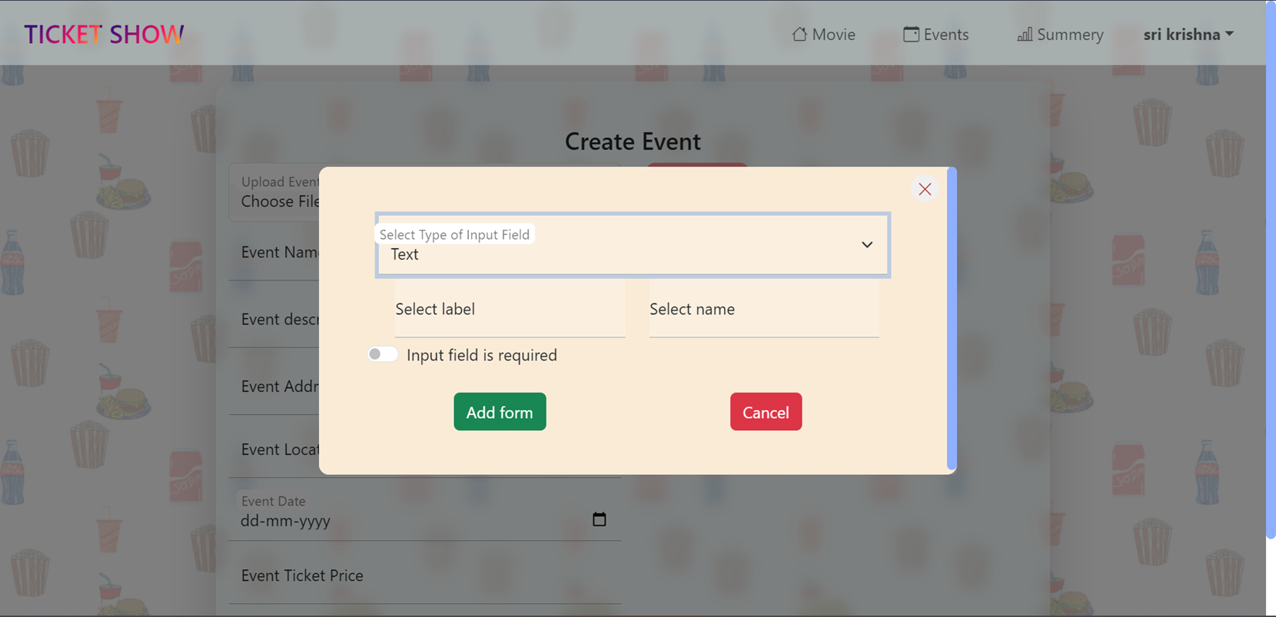
Adding dynamic form field

Slide 26
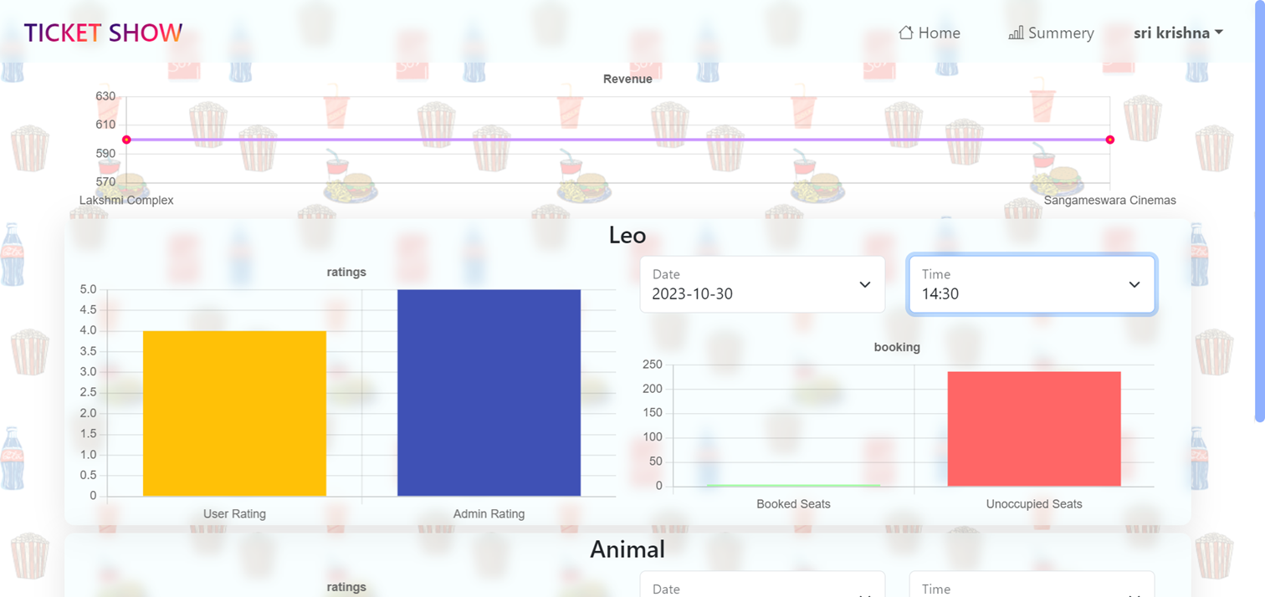
Summary / analysis

Slide 27
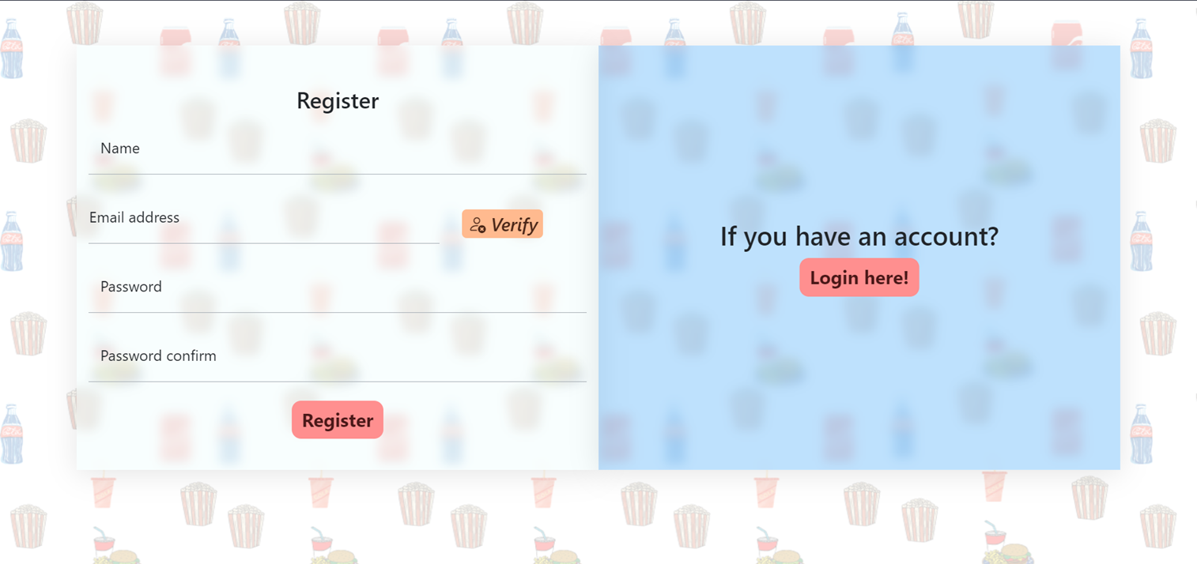
User registration Page

Slide 28
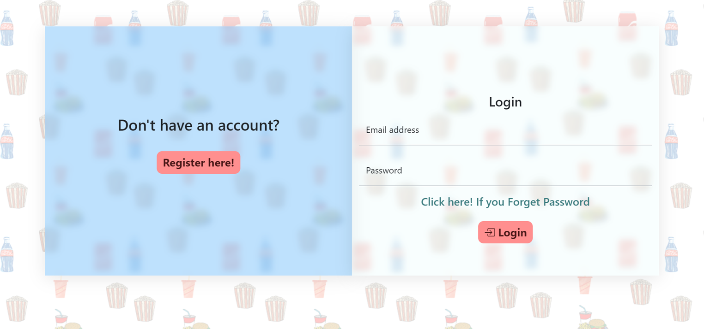
User login Page

Slide 29
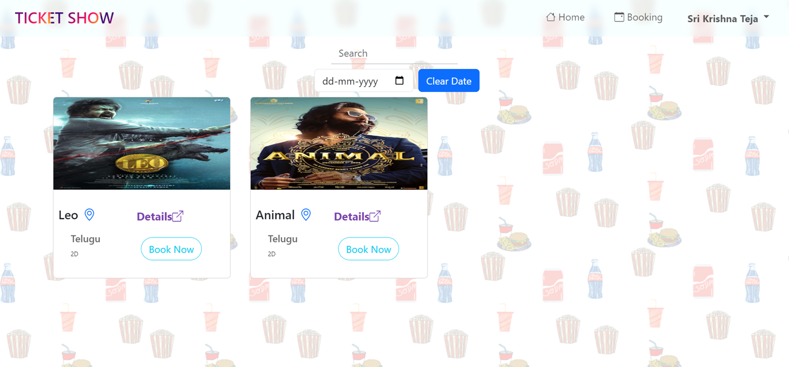
User movie home Page

Slide 30
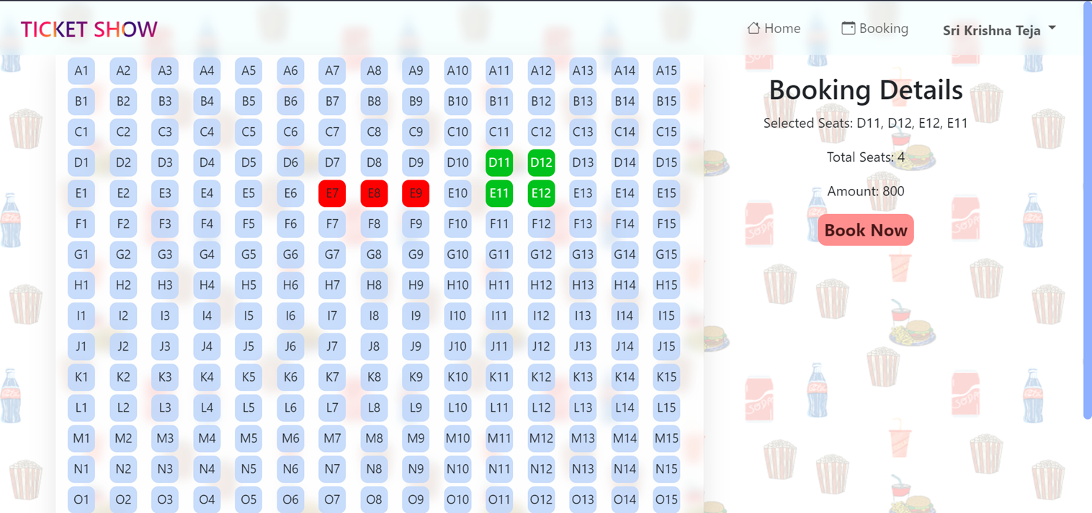
User movie ticket booking page

Slide 31
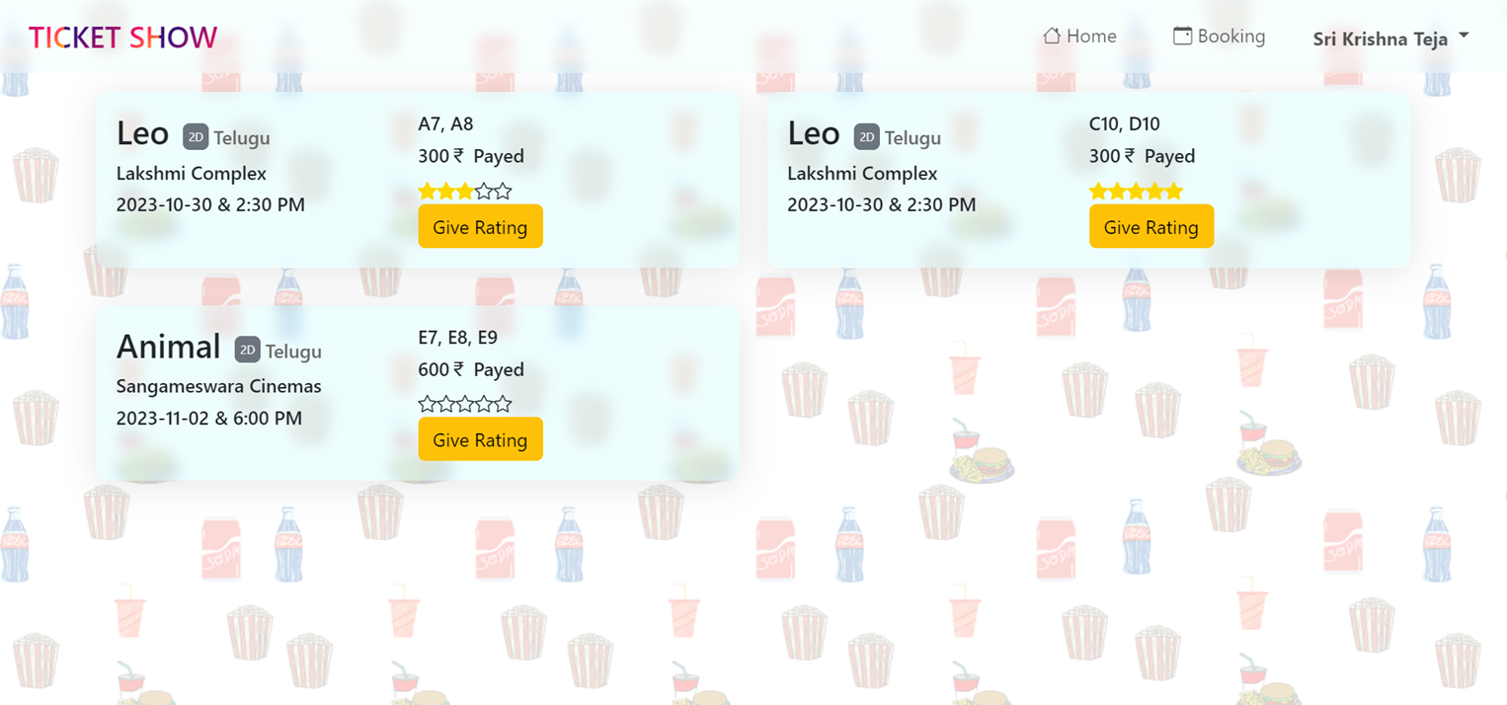
User event home Page

Slide 32
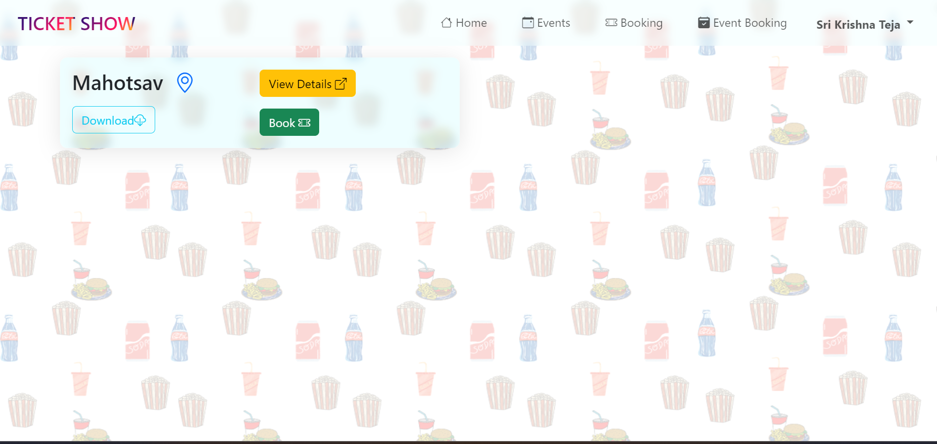
User booking history Page

Slide 33
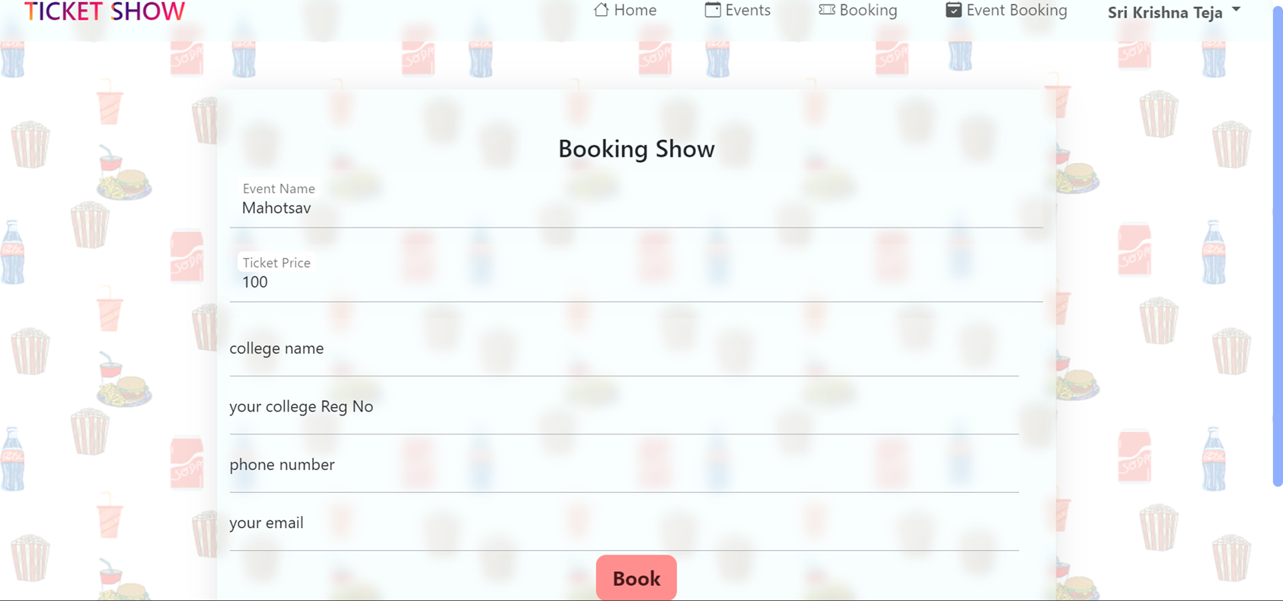
Event booking Page

Slide 34
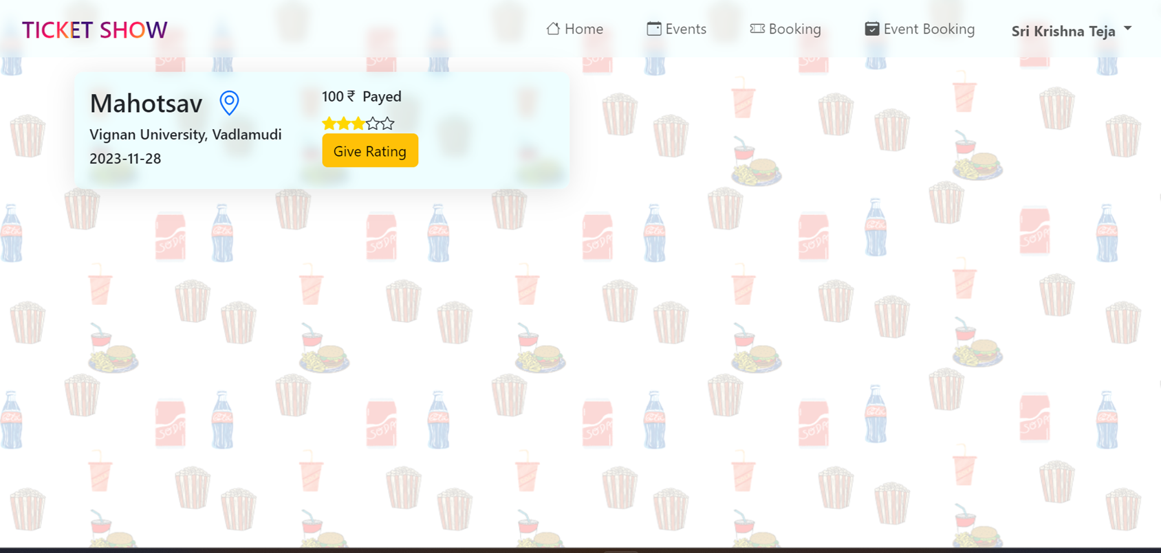
User event history bookings Page

Slide 35
CONCLUSION
The development of the Multi-User Movie & Event Ticket Booking Application has been a significant endeavour that aimed to revolutionize the way moviegoers’ access and book movie tickets. The project successfully achieved its objectives, resulting in a comprehensive platform that enhances the movie-going experience, ensures secure user interactions, and simplifies theatre and movie management and event management.
Ceo Of Ingoude Company

Slide 36



